Slide 1

CSC432 – Information Security
Dr. Adnan Ahmad

Slide 2
Course Introduction and Overview

Slide 3
Teaching Methodology
Tell me and I forget.
Teach me and I remember.
Involve me and I learn.
Benjamin Franklin

Slide 4
Some Background testing…
Ever wonder what that line at the bottom of the browser means?
What a firewall is?
Have you ever been authenticated?
Has your computer ever been hacked?
What is a VPN?
DNS compromised, heard of it?

Slide 5
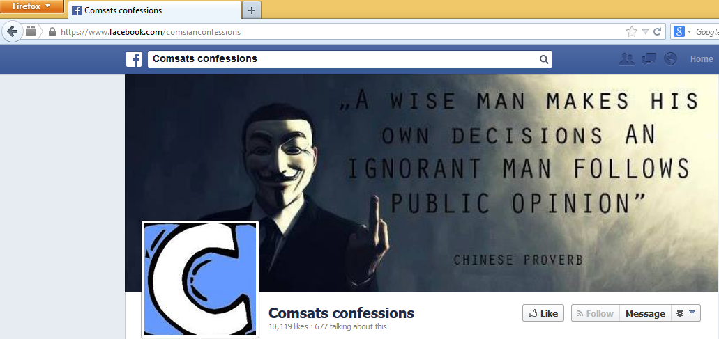
Welcome to CSC348
https invokes the Secure Socket Layer (SSL) communication security protocol to securely transmit your data to the server
SSL uses cryptography, which is used in Network Security

Slide 6
Welcome to CSC348
Other uses of cryptography
ATM machines
On-line banking
Remote login and file transfer using SSH
Digital rights management‎
E-commerce‎
Secret broadcasting
And many others….
Almost everywhere !

Slide 7
Data Security
Why is security necessary?
Because people aren’t always nice
Because a lot of money is handled by computers
Because a lot of important information is handled by computers
Because our society is increasingly dependent on correct operation of computers

Slide 8
Welcome to CSC432
“The art of war teaches us to rely not on the likelihood of the enemy's not coming, but on our own readiness to receive him; not on the chance of his not attacking, but rather on the fact that we have made our position unassailable.“
The Art of War, Sun Tzu

Slide 9
Data Security
How do security breaches impact organizations?
Effectiveness of primary operations are reduced
Financial loss
Damage to assets
Harm to individuals

Slide 10
How Systems Fail
Systems may fail for many reasons, including
Reliability deals with accidental failures
Usability deals with problems arising from operating mistakes made by users
Security deals with intentional failures created by intelligent parties
Security is about computing in the presence of an adversary
But security, reliability, and usability are all related

Slide 11
What Drives the Attackers?
Adversarial motivations:
Money, fame, malice, revenge, curiosity, politics, terror....
Fake websites: identity theft, steal money
Control victim’s machine: send spam, capture passwords
Industrial espionage and international politics
Attack on website, extort money
Wreak havoc, achieve fame and glory
Access copy-protected movies and videos, entitlement or pleasure

Slide 12
Other (Mutually-Related) Issues
Do consumers actually care about security?
Security is expensive to implement
Plenty of legacy software
Easier to write “insecure” code
Some languages (like C) are unsafe

Slide 13

Data Security
Layers of security
A lock is as strong as the weakest door
Application Security
Network Security
Operating System Security
User Security
Physical Security

Slide 14
Data Security
Data Security continues to be an issue for organizations
Not only are we hear about the successful penetration of web sites and hacking of networks, but we also have new laws and regulations that affect the protection of information
Australian Internet privacy policy
COMSATS Internet policy

Slide 15
Data Security
In response to these issues, more and more vendors are appearing with tools that offer some protection and claim that their product was the solution to the security problem
From looking at all of this information, it would appear that the big issues in security can be solved with technology
Unfortunately, security issues are much more complex than that

Slide 16
Data Security
Lets start with the basics …
So what is security?
Freedom from danger, safety; freedom from fear or anxiety
Security in computer terminology
Measures adopted to prevent the unauthorized use, misuse, modification, or denial of use of knowledge, facts, data, or capabilities
OR
Mechanisms to prevent, detect, and recover from network attacks, or for auditing purposes

Slide 17
Data Security – First Concepts
What is a secured network?
A network is “secured” if it has deployed adequate measures for prevention of, detection of, and recovery from attack

Slide 18
Data Security – First Concepts
At the very bottom, security is a people’s issue
We can not solve the basic problem with technology, but we can manage the security problem through the dedicated application of well-thought-out security processes and procedures

Slide 19
Data Security – First Concepts
So what we have learnt
You could build the biggest fortress in the world and someone could just come up with a bigger battering ram
Security is the name given to the preventative steps you take to guard your information and your capabilities

Slide 20
Data Security – basic principles
Security Principles To Follow
A 100% secure environment is a myth
The more you know about someone else, the better you can defend yourself from them
The more someone knows about you, the better they can exploit you
Security through obscurity doesn’t work
Never assume that all security risks are from the outside, and not the inside
Never assume that your users know what they are doing
Security is only as good as the weakest link in the chain
Security is a process, not an end product

Slide 21
Course Overview and Introduction
Pre-requisites
No (as per your SOS)
But I would strongly recommend this course for those who;
are familiar with basic computer networks
are preparing to investigate more details in selected topics and recent developments in network security
This is a theory course! Largely definitions and proofs, although of applied value

Slide 22
THANKS

